Slide 1
GO Team Meeting
Sylvan Hills Middle School
04/19/23

Slide 2
Agenda
Call to Order
Roll Call; Establish Quorum
Action Items
  Approval of Agenda
  Approval of Previous Minutes:
Discussion Items
  2023 Spring MAPS results
  BASC-3 results
  Needs Assessment
Information Items Principal’s Report
    2022-2023 Family Engagement and/or Partnership Highlights
  Cluster Advisory Team Report
  GO Team Elections
Announcements
Public Comment
Adjournment

Slide 3

2023 Spring
MAPS Results
Data Points to Consider
Spring Results
Fall to Spring Comparison
  Literacy
  Numeracy

Slide 4
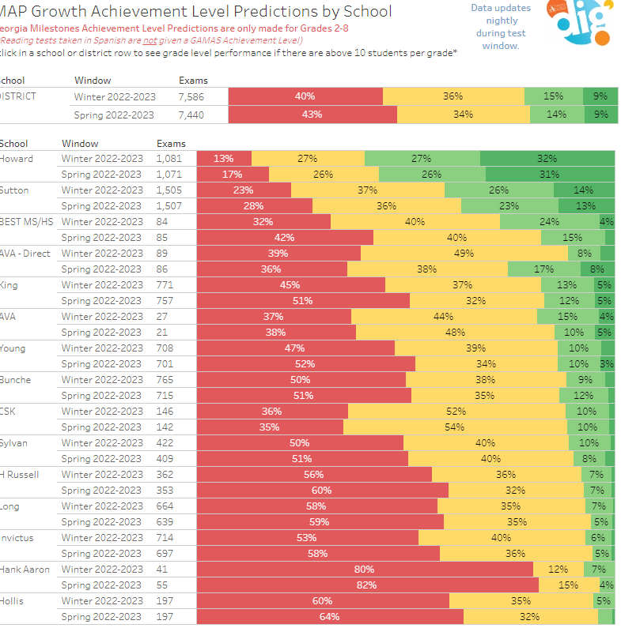
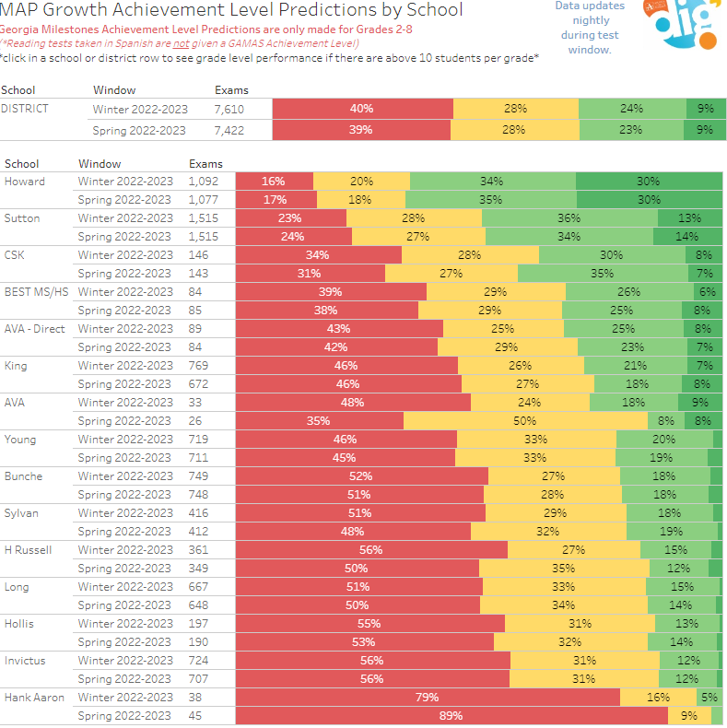

Slide 5
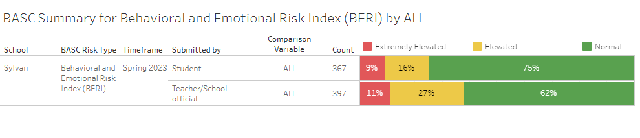

BASC-3 Data

Slide 6

Needs Assessment
Needs Assessment
During this Needs Assessment, we will look at data from the Spring MAPS administration and identify 2-3 potential needs for the 2023-2024 school year.
This discussion will help school leadership as they begin developing the school’s 2023-2024 Continuous Improvement Plan this summer.
ACTIVITY

Slide 7
Needs Assessment:
Guiding Questions
What does this data tell us?
What good news is there to celebrate?
Where are growth opportunities?
What trends do we see in the data?

Slide 8
Needs Assessment:
What are two to three (2-3) needs we can identify based our data?
 | Need
1
2
3

Slide 9

Principal’s Report

Slide 10
Additional Information Items
Cluster Advisory Team Report
GO Team Elections
  Find candidates at apsstrongschools.com
  Vote APRIL 18-27
  Households are sent a unique link based upon information in Infinite Campus
  School Staff will be sent a link to their APS email address

Slide 11

Announcements
GO Team Members
  Check your email starting May 1 for end of year survey links
    GO Team Satisfaction Survey
    Principal Feedback Survey
  Complete your required trainings ASAP
    Contact the GO Team Office with any questions

Slide 12


